Slide 1
Sample Selection
21/10/2023

Slide 2
Partition

Slide 3
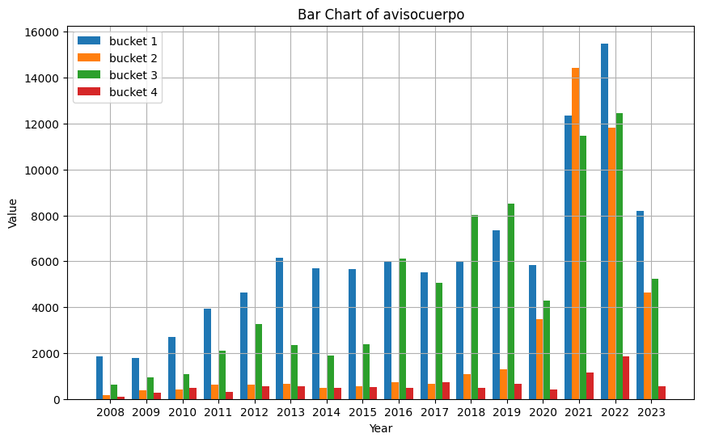
Time partition
Still to decide

Slide 4
Language partition within time period
Postings for period
Specific WFH phrase
No specific WFH phrase
Bucket 1
Negated specific WFH phrase or explicitly indicating WFO
Bucket 2
Non-negated specific WFH phrase
Bucket 3
Generic WFH phrase and derivations of generic phrases
Bucket 4
No generic WFH phrase, or explicitly indicating WFO

Slide 5
Dictionaries overview
Specific WFH phrases
Combine two existing dictionaries (OECD + Draca et al. (20222))+ hybrid
Original phrases due to the relatively extended use of english in job context in Latin America and translated
Generic WFH phrases:
Very broad phrases that are neccesary for communicating WFH

Slide 6
Specific WFH phrases examples
term | Source
Working remotely | OECD
Working from home | OECD
Wor remotely | OECD
Work at home | OECD
Teleworking | OECD
Home work | Draca et al.
Conducted remotely | Draca et al.
term | Source
Trabajo remoto | translation
Trabajo desde casa | Translation
Trabajo en forma remota | Translation
Teletrabajo | Translation
Trabajo a distancia | Translation
Trabajo virtual | Translation
Trabajo híbrido | translation

Slide 7
Generic WFH phrases
Subwords and expressions
In spanish subwording is not very common but there’s different ways to combine words to express something
Trabajo en el hogar
Trabajo en casa
Trabajo desde el hogar
Trabajo desde casa
And it can be said in different order, so to capture this we search for all the words in a particular generic phrase.
Key terms
Trabajo
Remoto
casa
Hogar
Distancia
Virtual
línea

Slide 8
Negated specific phrases
In spanish there’s different way to negate a phrase, we consider the most used:
No, no es and tampoco, ni (in special cases)
Also, as it is not common in spanish to talk negating a phrase, we count as negated those phrases that explicitly stand for WFO

Slide 9
Sample shares (within time period)
Still to define, maybe is not neccesary to simple within the buckets

